Slide 1

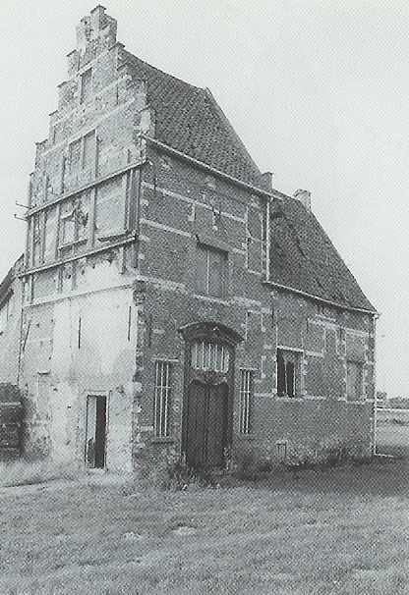
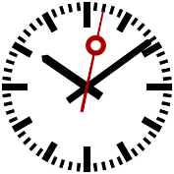



50min
The Mythical Man-Month
everybody quotes it, some people read it, and a few people go by it
Theoretical
TechEvent

Slide 2


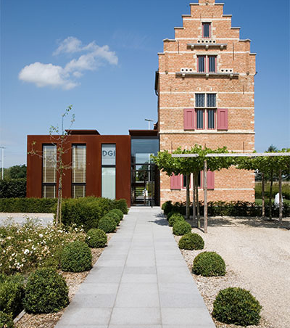

Menu
What
Essays
The Tar Pit
The Mythical Man-Month
The Second-System Effect
No Silver Bullet
“Honorable mentions”
Other resources

Slide 3


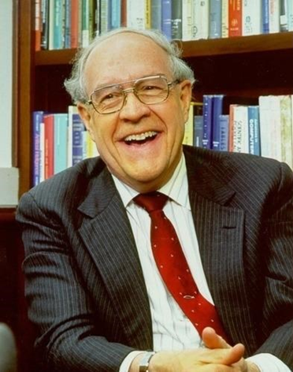

What
Fred Brooks (1931 → 2022)
IBM, OS/360
1975, revised in 1995
14-18 essays on software engineering and project management
Notes:
Man-Month: A hypothetical unit of work representing the work done by one person in one month

Slide 4
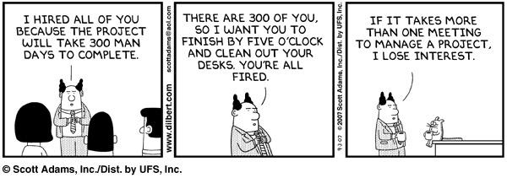
The Essays

Slide 5


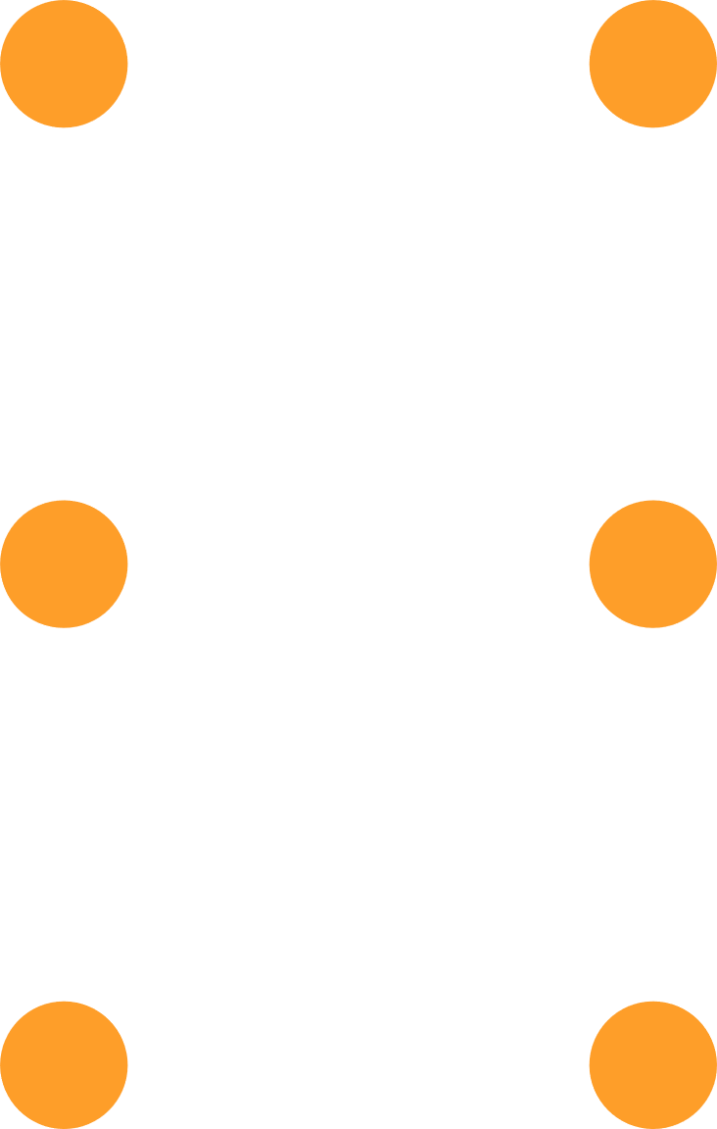
The (Software) Tar Pit
Notes:
The struggles of great beasts in the tar pits in prehistory.
The fiercer the struggle, the more entangling the tar, and no beast is so strong or so skillful but that he ultimately sinks.
Large-system programming (like OS/360) has been such a tar pit.
Most have emerged with running systems – few have met goals, schedules, and budgets.

Slide 6
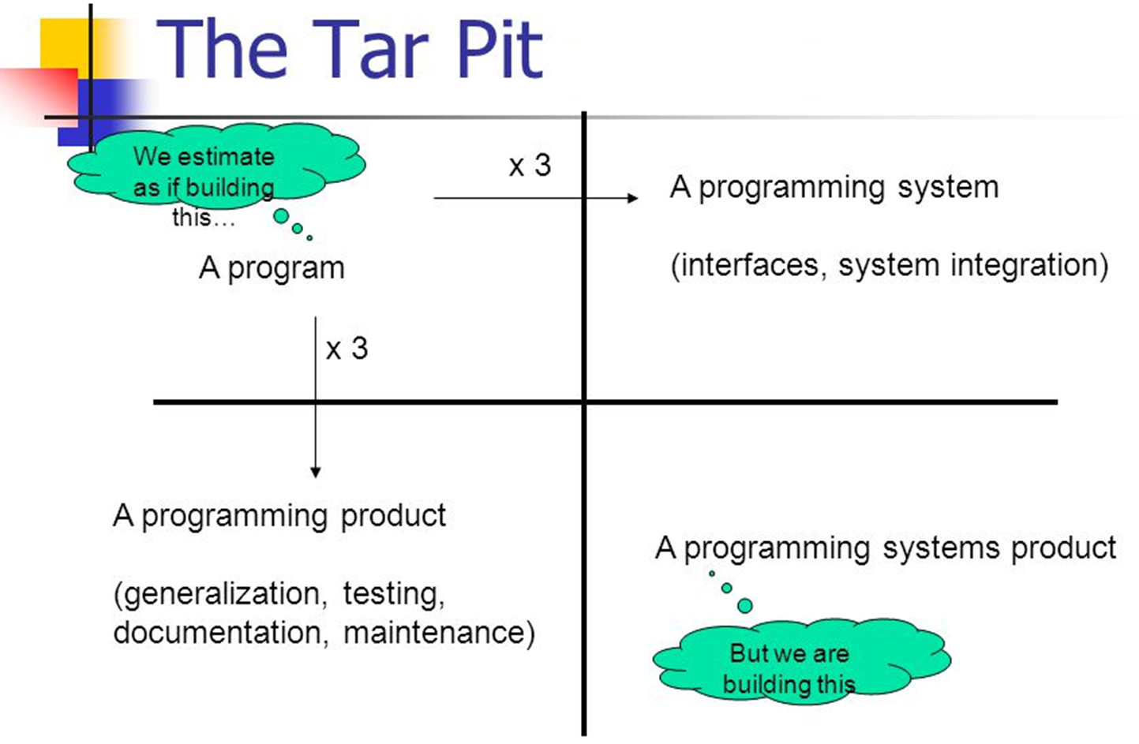
Notes:
A program:
A few developers, in a garage create something that surpasses the best efforts of large teams.
Needs to be converted into a more useful, but more costly, object.
A programming product (down):
It can be tested (all possible boundaries, tests are documented, recorded), repaired, and extended by anybody (documentation).
Generalization: Usable in many operating environments, for many sets of data.
A programming system (right):
A collection of interacting modules
Use only a prescribed amount of memory & time.
Testing with other components, with all possible inputs/outputs
Woes of the craft:
Integration: work done by others is maldesigned, not tested and poorly documented.
Debugging: The first bug is so much easier to find & fix compared to the last one(s).
Obsolete: The moment a design is freezed, it becomes obselete.

Slide 7


The Mythical Man-Month
Programmers are optimists
“This time it will surely run”
“I just found the last bug”
The assumption that “all will go well”

Slide 8
The Mythical Man-Month
Cost increases with the number of people per month worked
Progress may not
Man-Months as a unit for measuring the size of a job is a dangerous and deceptive myth

Slide 9
The Mythical Man-Month
People and months are interchangeable commodities only when a task can be partitioned among many workers with no communication between them.

Slide 10
The Mythical Man-Month
Training
Technology
Project Goals
Overall Strategy
Way of working
Intercommunication
n (n-1) / 2
3 workers == 3x 2 workers
4 workers == 6x 2 workers
Notes:
Training:
Is lineair.
Intercommunication
The work is not sequential (9 mothers one baby in a month)

Slide 11
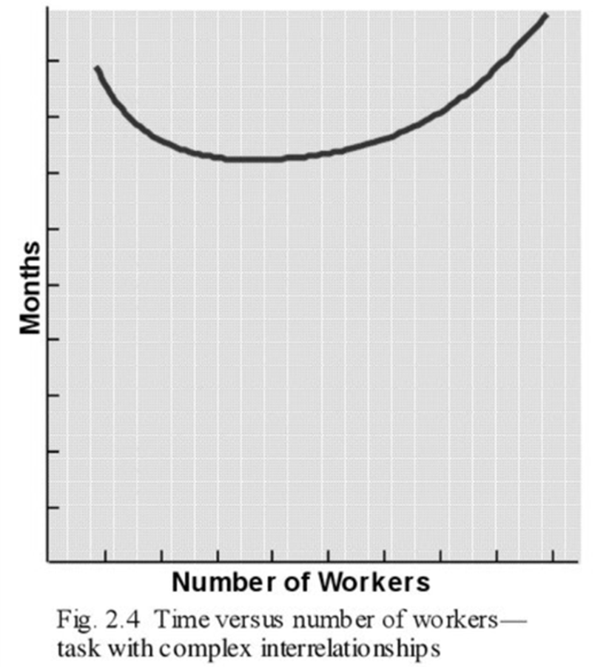
The Mythical Man-Month
Communication effort is great and quickly dominates the decrease in individual task time brought by partitioning
Time spent -- rule of thumb:
1/3 planning 1/6 coding 1/4 component & early system testing 1/4 system test, with all components
Notes:
Rule of thumb:
The smallest part, coding is typically the easiest to estimate

Slide 12

Brooks’s Law
Adding manpower to a late project makes it later
Notes:
Because
The added lineair training of the new workers
The additional inter communications required
20 year anniversary:
Adding additional manpower early on the project is much preferred
Adding manpower later always increases the cost but does not always make it later
Adrenaline Junkies & Template Zombies:
Time removes cards from your hand.

Slide 13
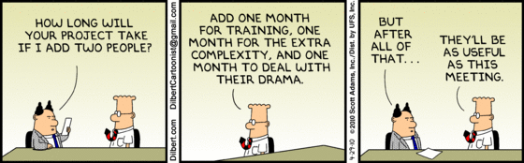
Brooks’s Law

Slide 14


The Second-System Effect
Adde parvum parvo magnus acervus erit.
(add little to little and there will be a big pile)
-- Ovid
Notes:
Ovid: Publius Ovidius Naso (Roman, 21 March 43 BC – 17/18 AD)
Perfection is achieved, not when there is nothing more to add, but when there is nothing left to take away. -- Antoine de Saint-Exupery.
Zawinski's Law:
Zawinski's Law of Software Envelopment, states that:
Every program attempts to expand until it can read mail. Those programs which cannot so expand are replaced by ones which can.

Slide 15
The Second-System Effect
The tendency of small, elegant, and successful systems to be succeeded by over-engineered, bloated systems, due to inflated expectations and overconfidence
Notes:
Feature creep
Gold-plating

Slide 16
The Second-System Effect
Self-Discipline
An architect’s first work is apt to be spare and clean
During design frills and embellishments occur to him
Stored for “next time”
Once the system is finished, the architect is ready for his second system
This is the most dangerous system a man ever designs
The general tendency is to over-design
Notes:
Spare & clean:
First system: the architect doesn’t really know what it is he’s doing and so does this carefully and with great constraint

Slide 17
The Second-System Effect
Featuritis: avoid overloading a system with features of marginal utility, at the expense of performance and even of ease of use
Define the user set
Who are they
What they need
What they think they need
What they want
Notes:
The user set:
It is far better to be explicit and wrong than to be vague.
UI/UX: Persona’s?

Slide 18
The Second-System Effect
How to avoid?
Insist on a senior architect that has at least two systems under his belt
Notes:
Also:
Remember the builder has the creative responsibility for implementation. The architect only suggests.
Listen to builder’s suggestions for architectural improvements

Slide 19
No Silver Bullet
Essence and Accident in Software Engineering
There is no single development, in either technology or management technique, which by itself promises even one order-of-magnitude improvement within a decade in productivity, in reliability, in simplicity

Slide 20
No Silver Bullet
Like the monsters of folklore transform from the familiar into horror, the (non-technical) project manager sees a straightforward project becoming a monster
Missed schedules
Blown budgets
Flawed products
Notes:
So we look for a silver bullet…

Slide 21
No Silver Bullet
Essential complexity: difficulties inherent to the nature of the software.
Accidental complexity: unintentional challenges created by the developers themselves
Notes:
Essential:
The domain. WHAT are we supposed to be building. The hard part is the specification. And design, testing and integration.
The complexity of software is an essential part. There inherently is no silver bullet.
Software is constantly under pressure for change.

Slide 22
No Silver Bullet
Past Breakthroughs solved Accidental Complexities
High-level languages
Object Oriented Programming
“Automatic” programming
Artificial Intelligence
Environment & tools
Notes:
Automatic programming: an euphemism for a higher level language

Slide 23
No Silver Bullet
Be wary of marketeers promising an order of magnitude improvement
Avoid constructing what can be bought
Rapid prototyping as part of planned iteration for establishing software requirements
Grow software organically: adding features as they are run, used and tested
Identify and develop the great conceptual designers of the rising generation

Slide 24
No Silver Bullet
The tar pit of software engineering will continue to be sticky for a long time to come

Slide 25


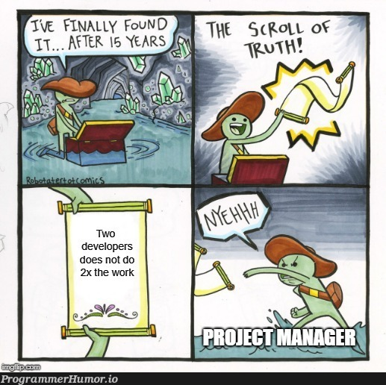
Other Essays

Slide 26
The Surgical Team
Managers prefer a small, sharp team of first-class people
VS brute forcing a solution with a large, and thus mediocre, team
Study Sackman, Erikson, and Grant
10x difference on productivity
5x difference on speed & space usage
No correlation between performance & experience (?)
But how to build really large systems?
Notes:
Small team: as few minds as possible
How to?
Split in different teams of 10 people
A chief-programmer, surgical team organisation
Ensure product integrity with as few minds as possible and many helpers with radically reducd communication
Surgeon: chief programmer
Co-pilot: able to do what surgeon does but is less experienced
Administrator: handles money, people, space, machines, etc...)
Editor: surgeon must do doc, but editor must clean it up
Two secretaris
Program clerk: maintaining technical records
Toolsmith: serves surgeon's need for tools, utilities
Tester: Devise system component tests, does debugging

Slide 27
Plan to Throw One Away
you will, anyhow
The first system built is rarely usable: too slow, too big, too hard to use, or all three
Discard and redesign may be done in one lump, or piece-by-piece but it will be done
Actual need and users’ perception of that need will change as programs are built, tested, and used
Valid changes in objectives, (and development strategies) are inevitable, and it’s better to be prepared for them than to assume they will not come
20YA: Too simplistic. Do NOT throw one away but build iteratively!
Notes:
The only constancy is change itself
Here the age of the books showed by advocating the use of top file headers to describe changes and versions. (git anyone)
Beta’s!!

Slide 28
Two Steps Forward and One Step Back
Maintenance is typically 40% or more of the total development cost
Fixing a bug has a 20 to 50% chance of introducing another
After each fix, one must run the entire bank of test cases
Add methods of eliminating or at least illuminating side effects
System Entropy rises over its lifetime
Repairs tend to destroy structure
Notes:
Typically done by a different team.
The architect has more than likely moved on

Slide 29
Hatching a Catastrophe
How does a project get to be a year late?
… One day at a time.
Typically not calamities but day-to-day slippage
The other piece is late anyway
Have a schedule
With concrete, specific, measurable events, sharply defined

Slide 30



Other Resources
Tom DeMarco & Timothy Lister
Peopleware: Productive Projects & Teams
Waltzing with Bears: Managing Risk on Software Projects
Adrenaline Junkies and Template Zombies: Understanding Patterns of Project Behavior

Slide 31
Peopleware (1987)
People are everything
(Well, almost everything)
The major problems of our work are not so much technological as sociological in nature.

Slide 32



THANK YOU!

Slide 33
WiFi: itenium-guest / Wifi4Ufree
New WiFi: ITENIUM_GAST / FreeWifi

